Slide 1
Electrical Load of Germany
Largest electricity-consuming sectors:
Industry (~42%) – Driven by steel, chemical, automotive, and manufacturing sectors.
Residential (~28%) – Main uses include heating, lighting, appliances, and rising EV charging.
Services / Commercial (~23%) – Offices, hospitals, data centers, and retail.
Transport (~7%) – Rail, metros, and EV charging etc.
How Electricity Demand Is Met (2024):
Renewables ~ 58%
led by onshore wind (23%) and solar (15.1%)
2024 Data
Conventional sources ~ 42
mainly lignite (16.1%) and natural gas (16%)
Since weekdays make up five out of seven days, the average daily load forecast is dominated by weekday patterns.
Typical Weekday Pattern:
Power demand starts climbing around 5 a.m. as people wake up and businesses begin their day.
Around midday to 3 p.m., demand eases slightly as factories break for lunch, offices slow down, and schools finish.
In the evening it rises again, as people return home, cook, and switch on lights and appliances, then begins to drops as the night settles in.

Slide 2
Energy shock after the Russia–Ukraine war driving visible industrial contraction post 2022.
Households and businesses increasingly produce and consuming their own electricity.
not visible on the national demand curve
Load in winter peaks due to heating demand and limited sunlight.
Fun fact:
In southern Europe and the Middle East, demand peaks in summer from air conditioning.

Slide 3
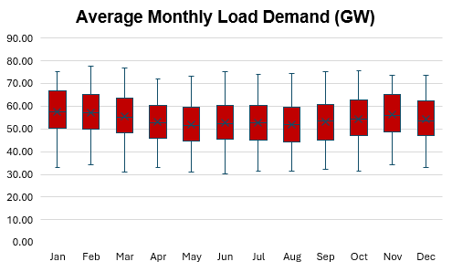
Statistical Insights
Monthly values remain relatively stable with no extreme seasonal variation.
The spread (IQR) is similar each month, indicating steady variability throughout the year.
No major outliers appear, suggesting stable behavior
Insights on Volatility:
Average volatility per day ± 6.9 GW
Date: 02.10.2020
January is the most volatile month with a SD 9.5 GW
Standard deviation : 11.06 GW
April is the least volatile month with a SD 8.6 GW
SD for the 10 most volatile days: 10.2 GW

